Slide 1
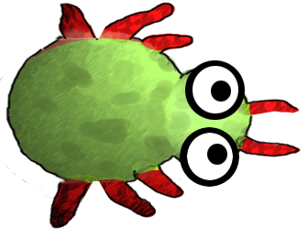
Return of the Greeps
CS18010
Team Members:
Tomos Fearn
Kamil Cupial
Ashley Evans
Sorres Arslan

Slide 2
What are we going to cover?
GitHub:
What it is?
How does it work?
Our experience?
GreenFoot:
What is it ?
Our Experience?
Greeps:
Our Modifications
Our Experience
Demo of our Greeps!
The experience of working in a group

Slide 3

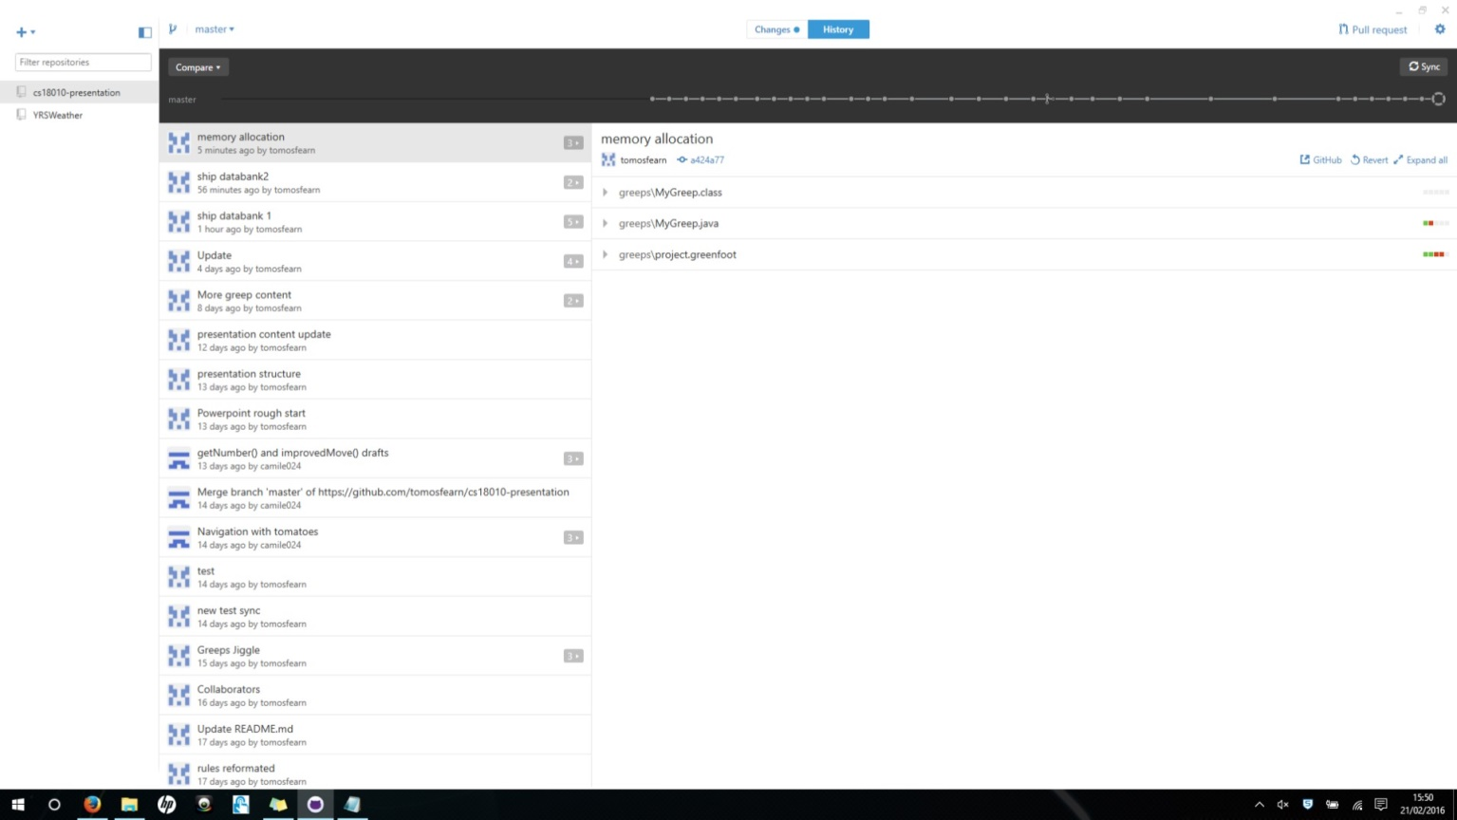
GitHub – What is it?
A
GitHub is a web based repository service
Designed for team projects
Free (Well mostly)
12 Million Active Users

Slide 4
How does it work?
A
I have no idea what to write here
I'm thinking about saying about forking, committing and pull requests
GitHub is a git repository web service which is based on Git software, Git software is used as a source code management system which is capable of revision control. There are other versions out there e.g. GitLab.

Slide 5
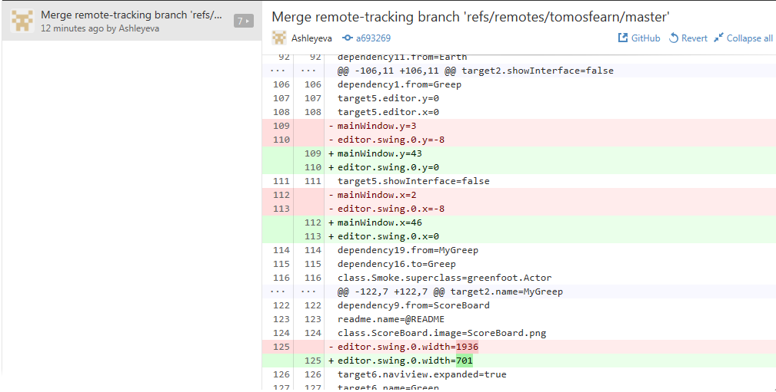
Our experience of GitHub
A
Good as long as you are careful
Provides lots of useful features such as:
Keeping track of changes
Shows exactly what changes have been made in code
Allows for version management

Slide 6

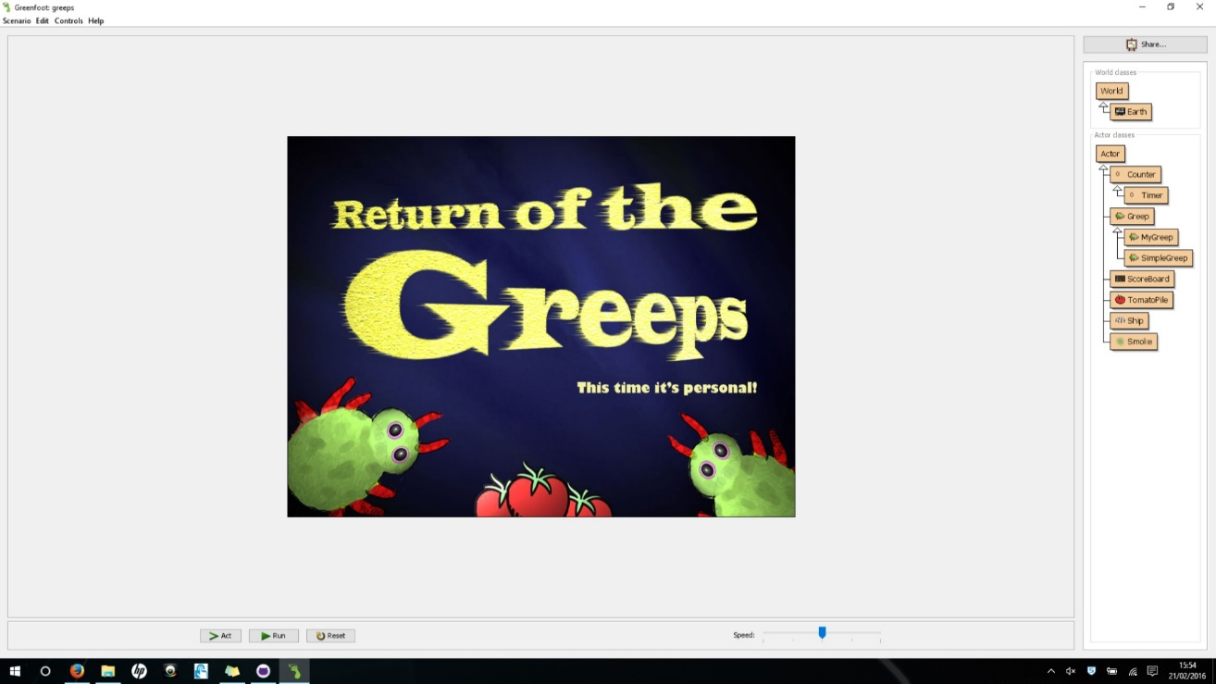
GreenFoot – What is it?
S
GreenFoot is a Java IDE primarily designed for educational purposes
Developed at the University of Kent
Available for Windows, OS X, Linux (Free)
Designed to be simple and easy to use

Slide 7
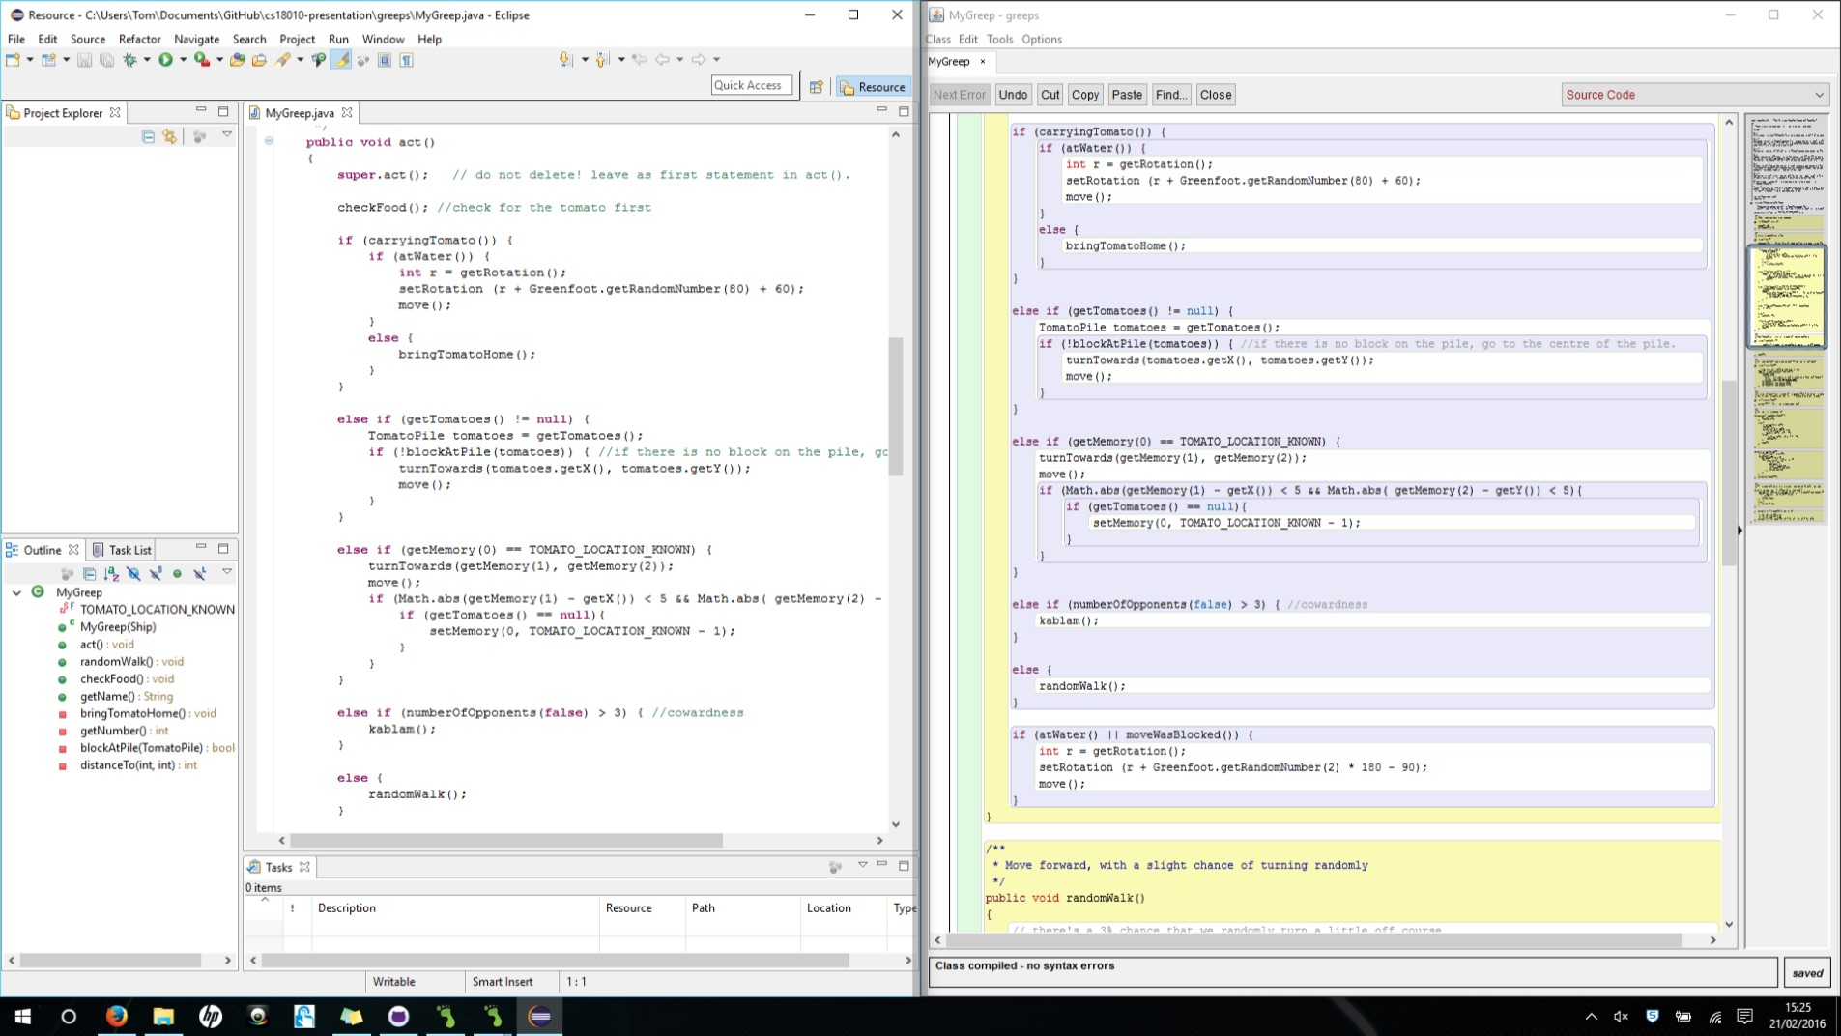

Our experience of GreenFoot
T
Difficult to find objects
Debugging can be unhelpful
Hard to read

Slide 8
Evolution of our Greeps…
K
What are the modifications we have made to the Greeps?
The experience we’ve had doing it.

Slide 9
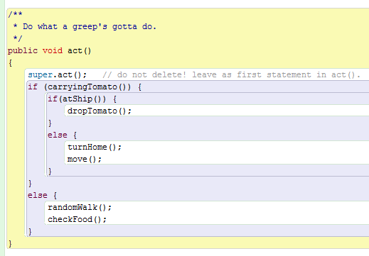
Our Basic Structure
K
Greeps are born very stupid and understand very little…
3 basic situations
If the Greep is carrying a tomato then run turnHome() and move().
If the Greep has arrived at the ship (Home) then drop the tomato.
Else wander about looking for tomatoes.

Slide 10
1st is the Greep carrying a tomato?
T
checkFood()

Slide 11
2nd bring the tomato home
T
if (carryingTomato()) {
if (atWater()) {
int r = getRotation();
setRotation (r + Greenfoot.getRandomNumber(80) + 60);
move();
}
else {
bringTomatoHome();
}
}

Slide 12
3rd go to the centre of the pile
T
else if (getTomatoes() != null) {
TomatoPile tomatoes = getTomatoes();
if (!blockAtPile(tomatoes)) { //if there is no block on the pile, go to the centre of the pile.
turnTowards(tomatoes.getX(), tomatoes.getY());
move();
}
}

Slide 13
4th if there are no tomatoes left clear memory
K
else if (getMemory(0) == TOMATO_LOCATION_KNOWN) {
turnTowards(getMemory(1), getMemory(2));
move();
if (Math.abs(getMemory(1) - getX()) < 5 && Math.abs( getMemory(2) - getY()) < 5){
if (getTomatoes() == null){
setMemory(0, TOMATO_LOCATION_KNOWN - 1);
}
}
}

Slide 14
5th suicidal Greeps
K
else if (numberOfOpponents(false) > 3) {
kablam();
}

Slide 15
6th tomato hunt
K
else {
randomWalk();
}

Slide 16
Pseudo Code
T
Link to pseudo code

Slide 17
Our Experience with modifying the Greeps: (Java)
K
The problems we encountered and how we solved them?

Slide 18
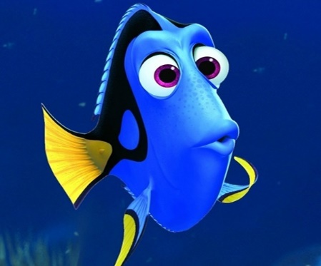
Our Main Problems
T
?
The memory of the Greeps were one of the biggest problems during the project
Problem:
The Greeps couldn’t remember where the tomato pile was located
Solution:
Every time a Greep picks up a tomato it registers the location of the pile in its memory so it remembers where to find the tomatoes when it takes the tomato back to the ship.
Greeps are forgetful
?

Slide 19

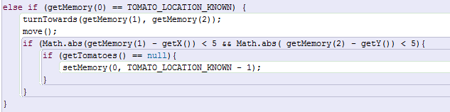
Our Main Problems
K
?
The invisible tomatoes
Problem:
Greeps return to the location where they found tomatoes and then stay there even when there are no tomatoes left.
Solution:
If the greep returns to its location where it knows the tomatoes are, but there are null tomatoes clear the memory and carry on randomWalk().
These tomatoes don’t have an invisibility cloak, the Greeps just return to the location and get stuck where they last found a tomato even when there are none left in the location.

Slide 20
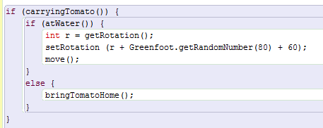
Our Main Problems
T
Water is an obstacle. Engage the Greep Jiggle!
Problem:
As our Greeps were on their way back to the ship they would get stuck at the water.
Solution:
We make the Greeps Jiggle their way around the water obstacle.
Our Greeps dance out of trouble…

Slide 21
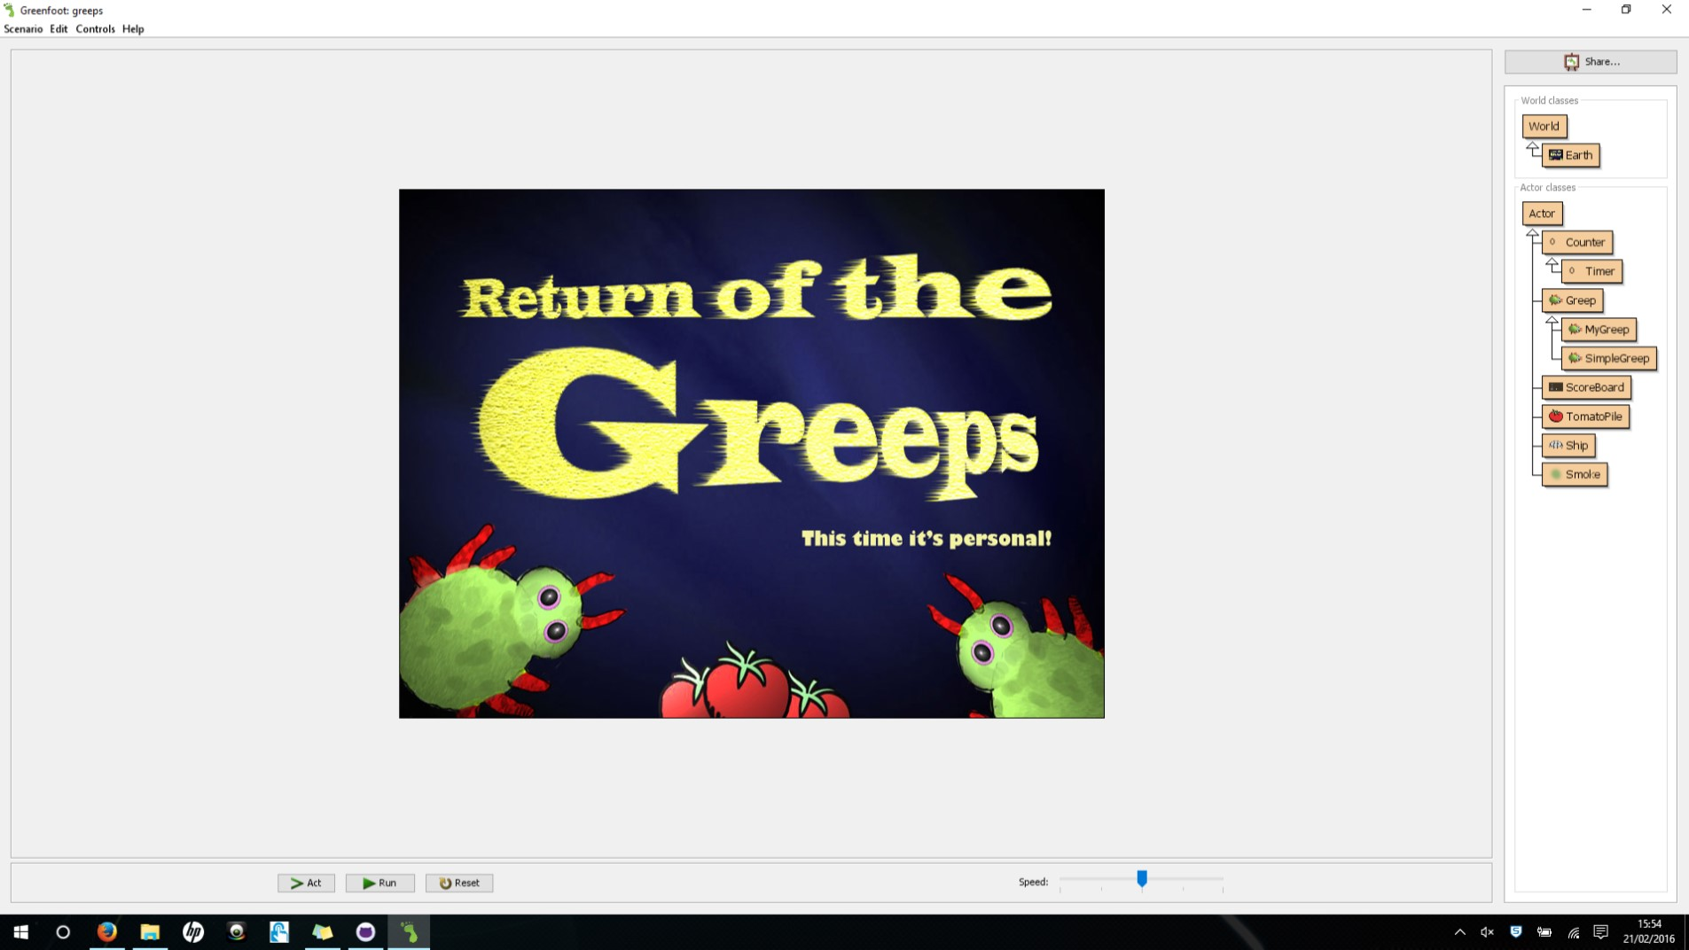
The Demo
T
Our Demo!

Slide 22
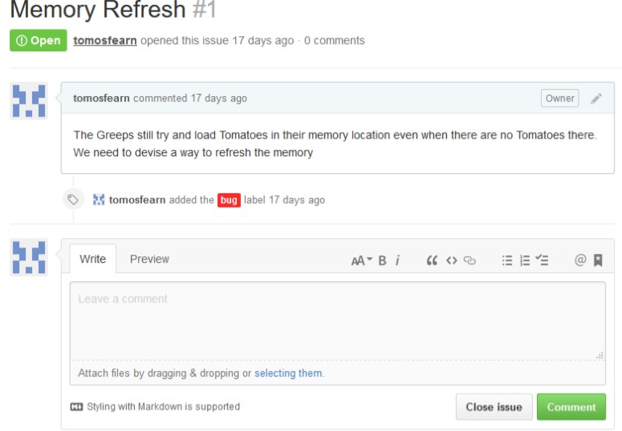
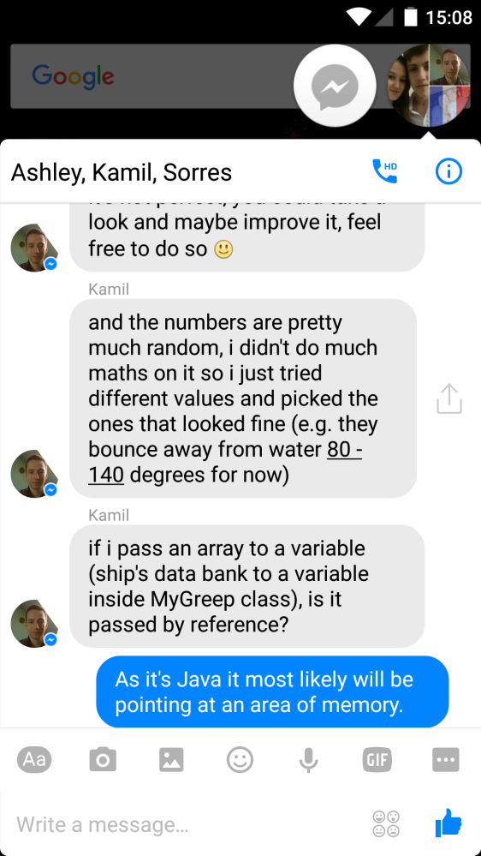
Our Teamwork
Facebook Messenger
GitHub Debug

